Slide 1

Legal Use Cases
for Blockchain & Smart Contracts
Presented at The Osgoode Certificate in
Blockchains, Smart Contracts and the Law Program
Dazza Greenwood
MIT Media Lab
law.MIT.edu
November 28, 2018

Slide 2
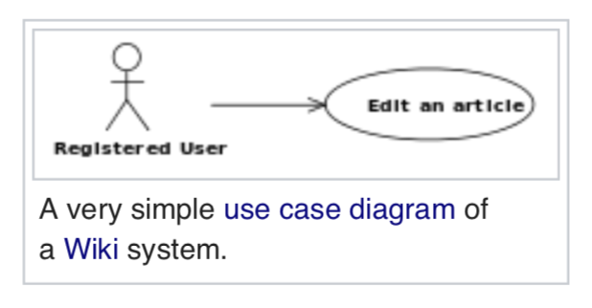
What is a
Use Case?
A Very Simple Use Case

Slide 3
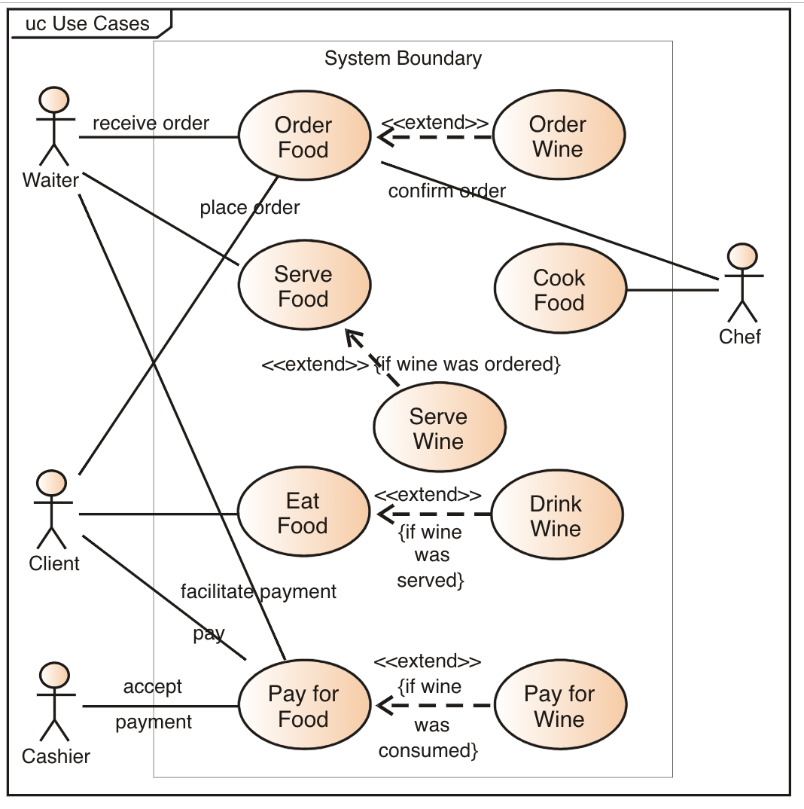
What is a
Use Case?
A Simple Use Case

Slide 4

What is a
Use Case?
Actor

Slide 5
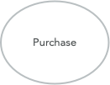
What is a
Use Case?
Action

Slide 6
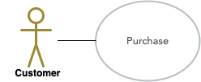
What is a
Use Case?
Actor + Action

Slide 7
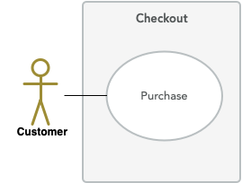
What is a
Use Case?
System Boundary

Slide 8
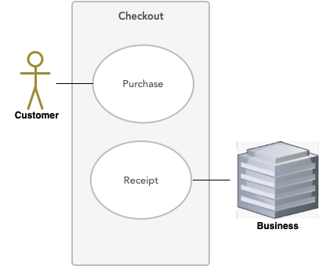
What is a
Use Case?
Multiple Actors + Actions

Slide 9
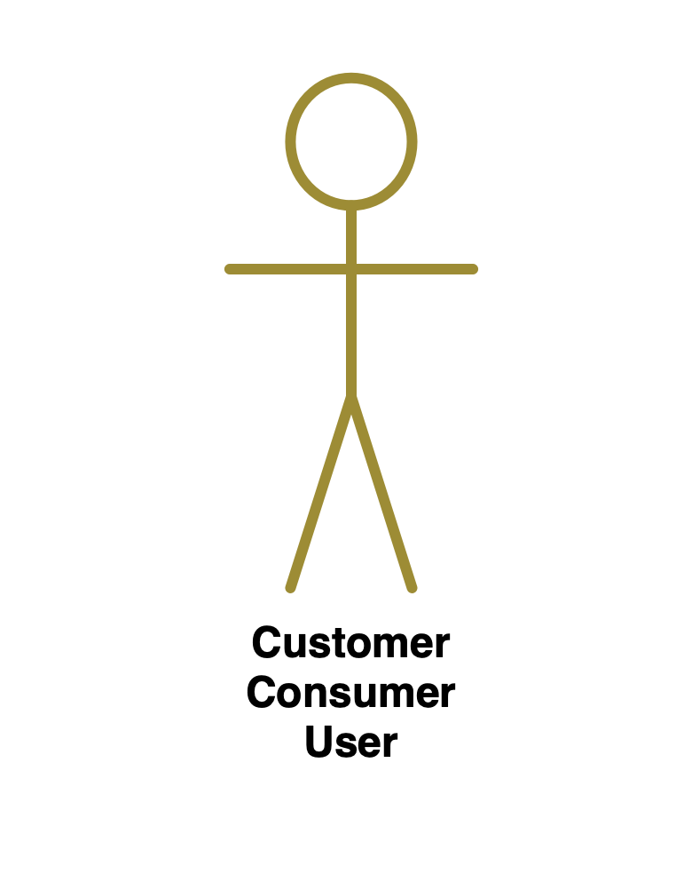
What is a
Use Case?
Who is the Actor?

Slide 10
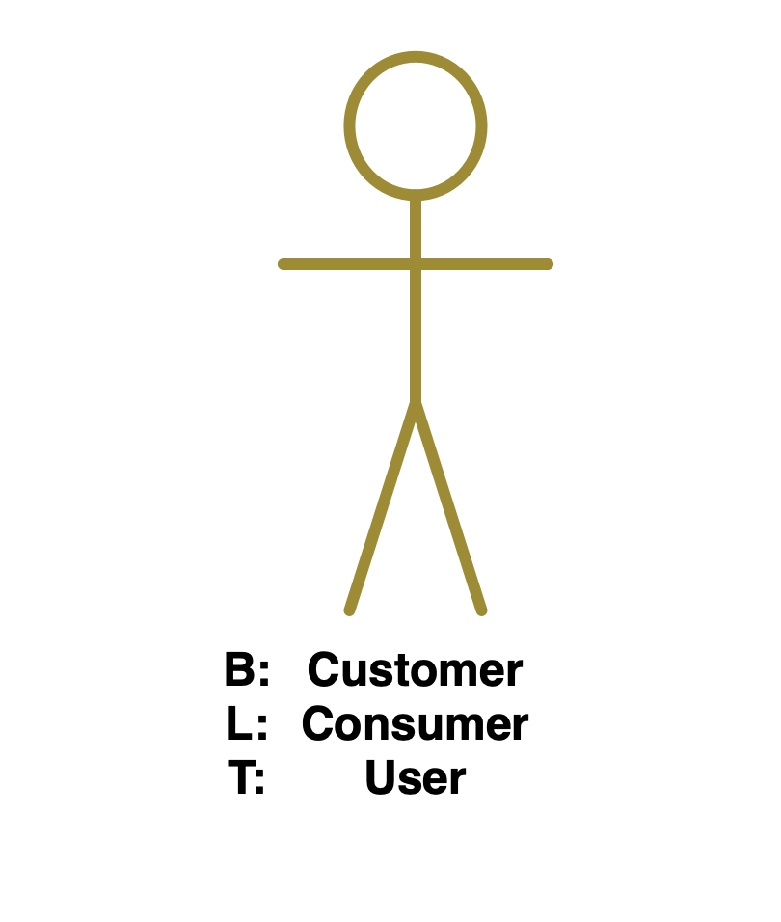
What is a
Use Case?
Who is the Actor?

Slide 11
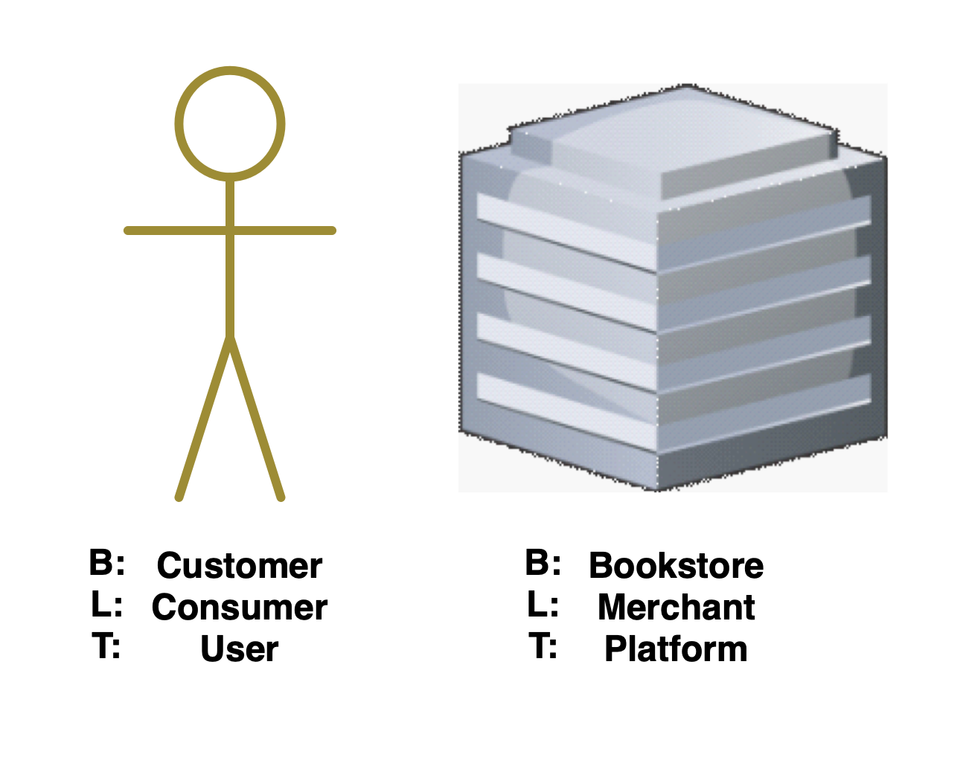
What is a
Use Case?
Who are the Actors?

Slide 12
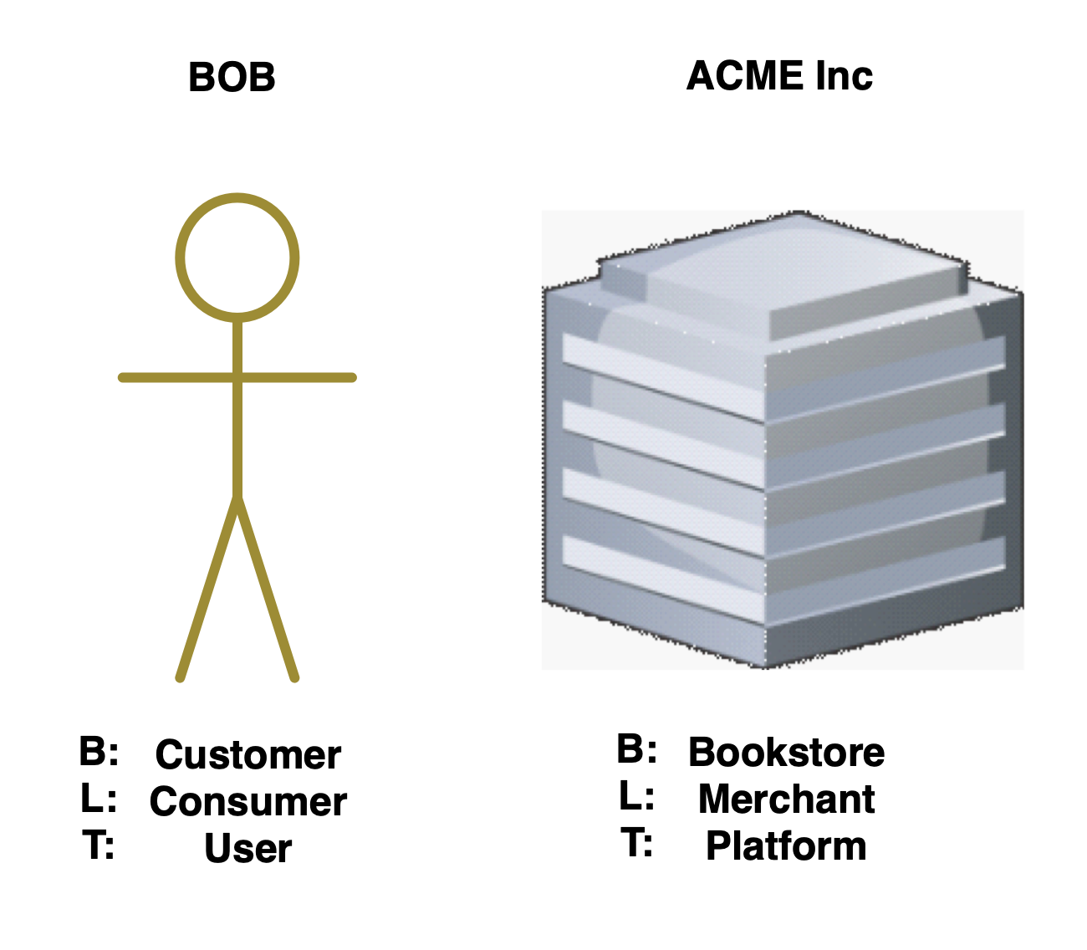
What is a
Legal Use Case?
Who are the Parties?

Slide 13
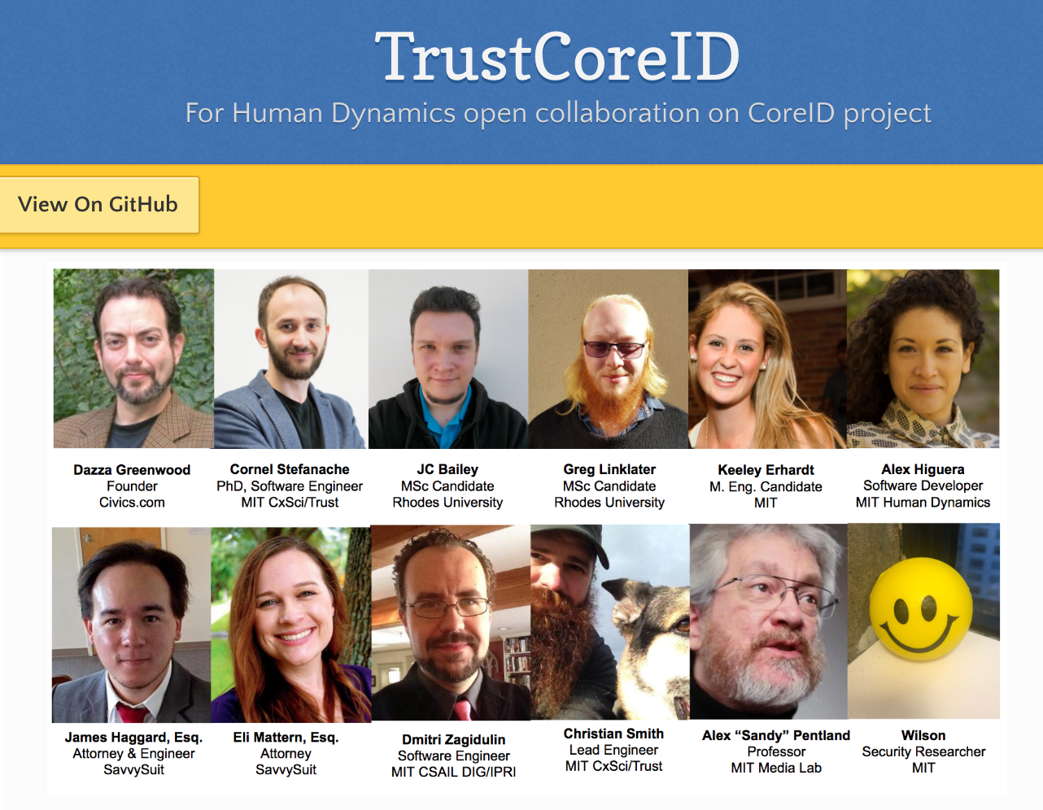
What is a
Legal Use Case?
Blockchain Signature Mock Trial
* Basic open source prototype of Blockchain Digital Signature:
https://mitmedialab.github.io/TrustCoreID
Predictable Legal Outcomes

Slide 14
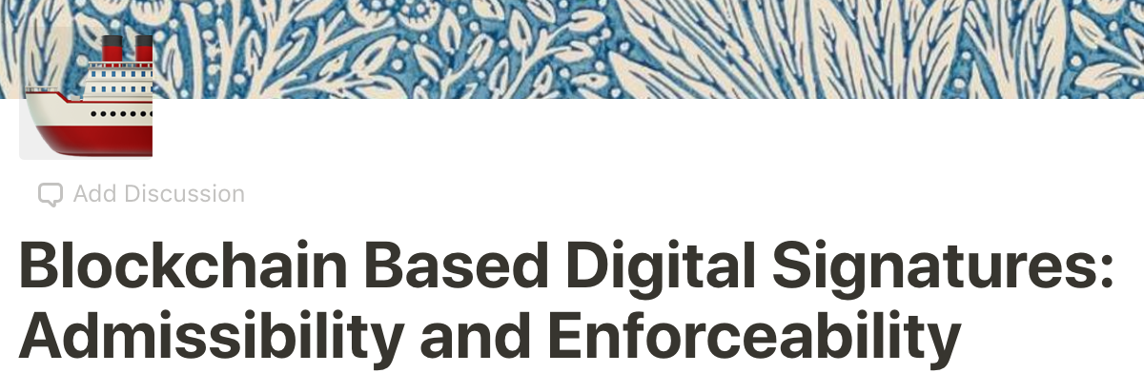
What is a
Legal Use Case?
Blockchain Signature Mock Trial
* Mock Trial approach to test legal assumptions:
https://www.notion.so/Blockchain-Based-Digital-Signatures-Admissibility-and-Enforceability-74f6b861f3d44b0c9ef96bc40d436ee2
Predictable Legal Outcomes

Slide 15
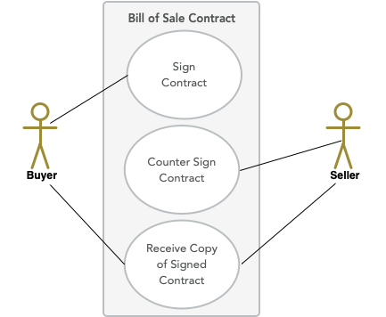
Blockchain Legal Signature
Use Case
Blockchain Signature Mock Trial
Blockchain Digital Signature on Bill of Sale:
Buyer and Seller have Bitcoin or Ethereum Addresses
Buyer and Seller agree to private purchase and sale of a car
Parties sign Bill of Sale using digital signatures with Blockchain keys
Dispute;
1. Buyer transfer money but doesn’t get car or gets lemon OR
2. Seller delivers car but doesn’t receive agreed payment
Describe admissibility and enforceability issues on this contract
https://mitmedialab.github.io/TrustCoreID

Slide 16
What is a
Legal Use Case?
Blockchain Signature Mock Trial
Questions surfaced by the Mock Trial include whether:
* the parties have access to anybody who is qualified and has standing to lay a foundation for admissibility through first hand or expert testimony
* the cryptographic and other verifiable data is correctly aligned to the specific activity and records necessary to legally attribute the technical signature processes to a given legal party (ie: can we prove which person in fact executed the digital signature?)
* the purported signatory in fact had the requisite legal intent to sign (ie to authenticate, be bound by, assent to, attest, condent, acknowledge, agree, authorize, etc) the contract or other record in question
* the right evidence was created and properly maintained sufficiently to prove a valid chain of custody occurred
Predictable Legal Outcome

Slide 17
What is a
Legal Use Case?
A: Identify People and Systems:
B: Roles + Relationships
L: Parties + Transactions
T: Actors + Actions
B: Identify the Legal Dynamics:
Rights + Responsibilities
Causes of Action + Defenses
Recourse + Remedies
Predictable Legal Outcomes

Slide 18
What is a
Legal Use Case?
Blockchain Signature Mock Trial
Critial Take-Away: Provably linking parties to relevant actions is critical for legal attribution
Predictable Legal Outcomes

Slide 19
What is a
Blockchain?
Attribution Under the UETA:
(a) An electronic record or electronic signature is attributable to a person if it was the act of the person. The act of the person may be shown in any manner, including a showing of the efficacy of any security procedure applied to determine the person to which the electronic record or electronic signature was attributable.
(b) The effect of an electronic record or electronic signature attributed to a person under subsection (a) is determined from the context and surrounding circumstances at the time of its creation, execution, or adoption, including the parties’ agreement, if any, and otherwise as provided by law.
Attribution

Slide 20
What is a
Blockchain?
Attribution Under ULCA:
"The Uniform Act does not say how to show who signed an electronic document. Attribution is left to ordinary methods of proof, just as it is for documents on paper. The person who wishes to rely on any signature takes the risk that the signature is invalid, and this rule does not change for an electronic signature."
Attribution

Slide 21
References
What is a UML Use Case?
https://en.wikipedia.org/wiki/Use_case
https://en.wikipedia.org/wiki/Use_case_diagram
Blockchain for Lawyers?
https://computationallaw.org/blockchain-briefing-450aa4fb8d7c
What is a BLT Swimlane Diagram?
https://mitmedialab.github.io/law.MIT.edu/Diagrams
Relevant Links

Slide 22
Why Blockchain Stands Out & An Introduction to Smart Contracts

Slide 23
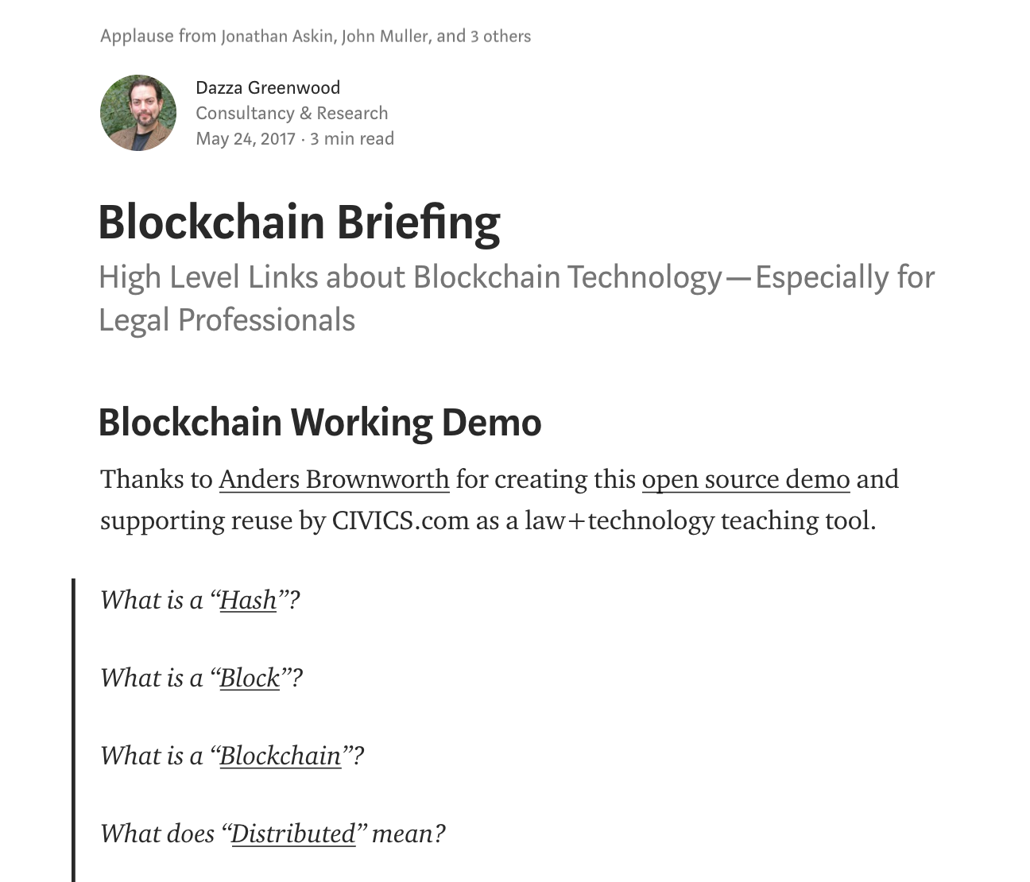
Blockchain for Lawyers
The Blockchain Briefing
https://github.com/mitmedialab/BlockchainBriefingBook

Slide 24
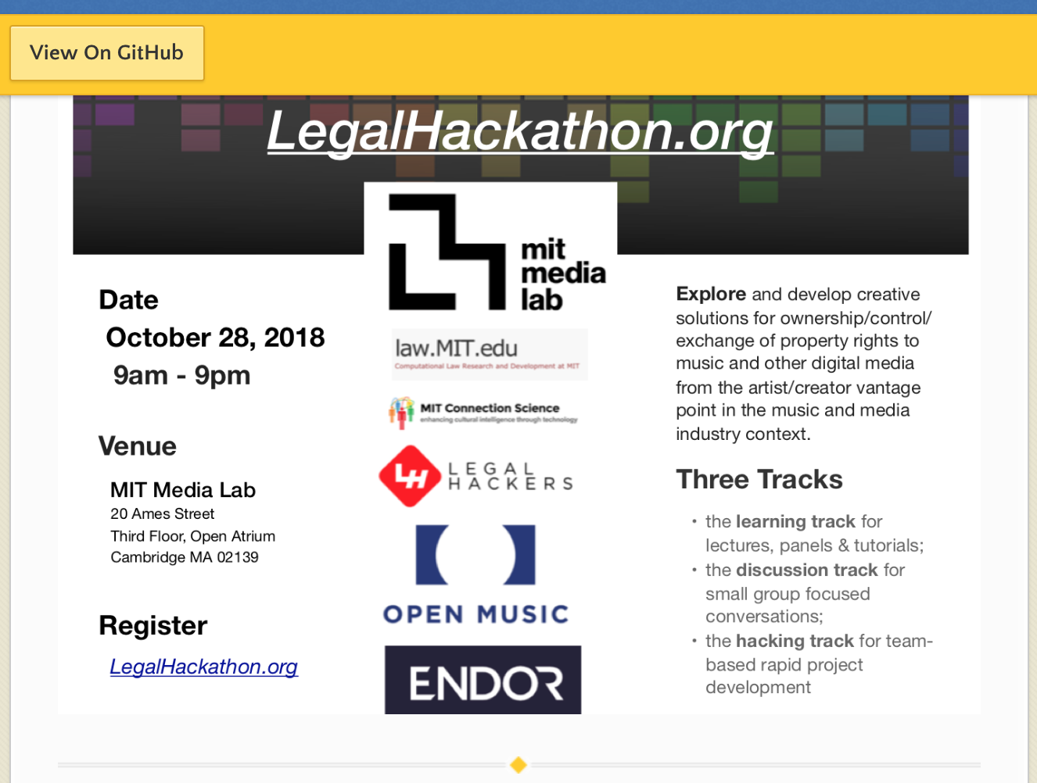
Smart Contracts for Lawyers
LegalHackathon.org
RChain
Monax
Open Law
Accord Project
http://legalhackathon.org/#resources

Slide 25
Fireside Chat: Sovereignty in a Blockchain World
Notes:
Who makes the rules in a blockchain world; who will exercise sovereignty? In this talk, Dazza Greenwood shares his research into what is driving the transformation of global institutions of governance and exchange. We explore the implications of these tendencies in the construction of future sovereignties and point to opportunities for technologists to ally with cooperativistas in building a decentralized, democratic sovereignty organized through a technological commonwealth
Obtain a basic understanding and appreciation for why blockchain offers a powerful infrastructure to identity attestations. The Self Sovereign Identity movement uses a blockchain to addresses several solution requirements but the most basic is for the secure and authentic exchange of keys which was not possible using PKI. Minimally, you should now be armed with enough awareness of decentralized identity principles to establish some doubt for those advocates that champion the use of blockchain.

Slide 26
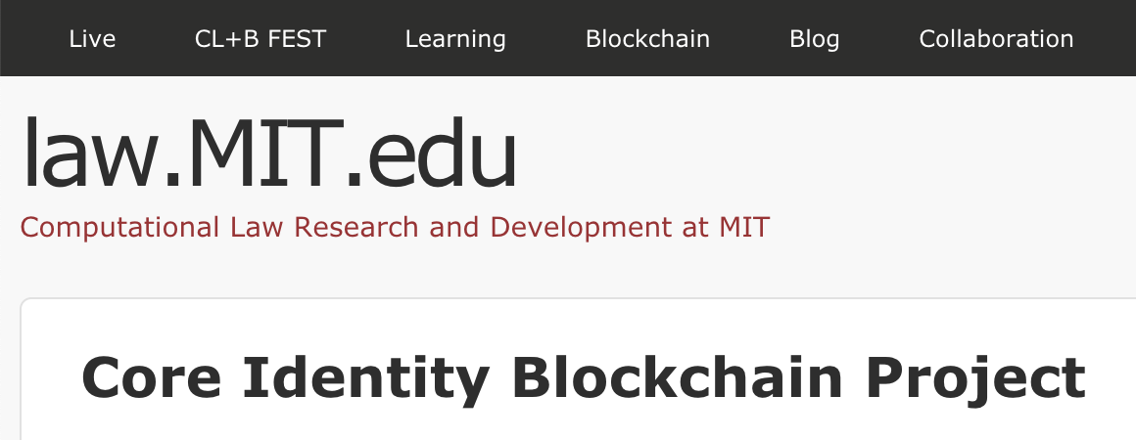
Sovereign Identity
http://law.mit.edu/blog/core-identity-blockchain-project
https://hackmd.io/VyTJbddPQIeaIDZZWCWZxg
Future Sovereignty

